Slide 1

Reducing bias in the probabilistic evaluation of Audio Music Similarity
Adriana M. Suárez I
Supervisor: Julián Urbano

Slide 2
Content
Introduction
Motivation
State of the Art
Methodology- Results
Short-term planning

Slide 3
M.I.R
A.M.S
I.R
Evaluation
Cranfield

Slide 4
M.I.R
A.M.S
Large collections of electronic text and other human-language data.
I.R
Evaluation
Cranfield
Notes:
Its the field: concerned with representing, searching, and manipulating large collections of electronic text and other human-language data.

Slide 5
M.I.R
A.M.S
Extraction of meaningful features of music.
I.R
Evaluation
Cranfield
Notes:
Music Information Retrieval (MIR) is concerned on the extraction and inference of meaningful features of music

Slide 6
M.I.R
A.M.S
I.R
M.I.R initially followed the evaluation practices of text
Implementation of standard and rigor on investigation
Evaluation
Cranfield
Notes:
Determine how well the IR system is performing
Evaluation has come to play a critical role in information retrieval research (Downie, 2002). The IR community has paid a lot of attention to the topic, implementing evaluation standards and experimental rigor on investigations, which have been effective in moving the field forward.
M.I. R initially followed the evaluation practices of text; however, not enough research has been done to properly know when this approach can be fully applied or not because music, unlike text has, a complex nature

Slide 7
M.I.R
A.M.S
I.R
Test Collection
Queries
Relevance Judgments
Evaluation Metrics
Evaluation
Cranfield
Notes:
Se evalúa con Cranfield

Slide 8
M.I.R
A.M.S
I.R
Discover similar songs.
Evaluation
Cranfield
Notes:
Audio Music Similarity (AMS) deals with the challenge of discovering similar songs. It is generally used in MIR task such as music recommendation, playlist generation or plagiarism detection

Slide 9
M.I.R
A.M.S
I.R
Focus of this thesis
Evaluation
Cranfield

Slide 10
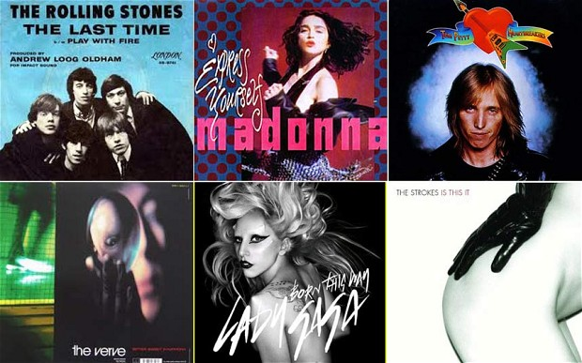
A.M.S in MIREX
Annual evaluation of MIR algorithms
Evaluation in A.M.S:
For an audio clip (the query), a system returns a list of songs from a corpus sorted by their musical similarity to the query.
Notes:
Music Information Retireval Evaluation eXchange (MIREX) is an annual evaluation of MIR algorithms
Audio Music Similarity (AMS) deals with the challenge of discovering similar songs. It is generally used in MIR task such as music recommendation, playlist generation or plagiarism detection

Slide 11

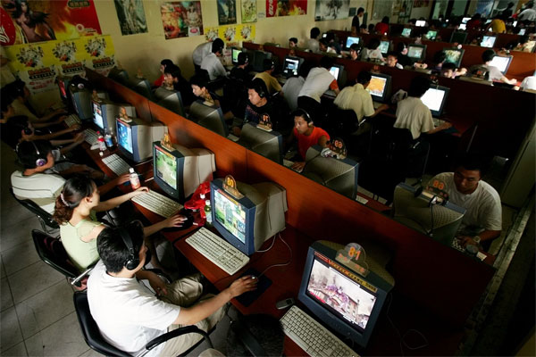
Annotations
Information contrasted using human assessors
Two scales: Broad-Fine
Notes:
After algorithms return results, this information is contrasted by subjective ground truth made by human assesors, using two scales called Broad and Fine

Slide 12
Annotations
Time consuming
Expensive
Boring
Solution:
Low cost evaluation methodologies
Notes:
After algorithms return results, this information is contrasted by subjective ground truth made by human assesors, using two scales called Broad and Fine

Slide 13
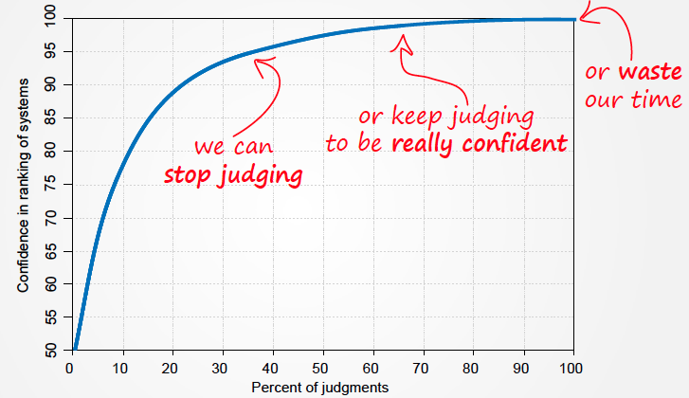
Probabilistic Evaluation
Confidence
Annotations
Notes:
Achieve a high level of confidence, decreasing the number of annotations and still be confidence about the results

Slide 14

Motivation
Improve efficiency in evaluation of A.M.S task in MIREX
reducing the number of needed relevance judgments

Slide 15

Scope
Proposed probabilistic models to predict annotations
Improve
Models
Probabilistic framework for AMS evaluation
Estimated systems effectiveness
Systems Outputs
Human assesors
Notes:
System Outputs: Documento que recupera cada sistema con cada consulta
Modelo para predecir, gente que has hace cuand se le pida, salida de sistemas, se mete en la caja para estimar la efectividad. Mi parte de trabajo es mejorar los modelos
Còmo se reducen? Prediciéndolas.

Slide 16
Content
Motivation
State of the Art

Slide 17
Low cost evaluation methodologies
Crowdsourcing
Decrease number of judgments
Evaluate Systems with incomplete judgments
(Carterette, Allan, & Sitaraman, 2006)
(Buckley and Voorhees, 2004)
(Alonso, Rose, & Stewart, 2008).
(Spärk Jones & van Rijsbergen, 1975)
Notes:
If we search in the literature, we have others low cost evaluation approaches:
For instance:
Crowdsourcing
Decrease the necessary number of judgments. Using a pooling method, in order to use just the top most ranked documents
Evaluate systems with incomplete judgments: Confident with results of the experiments. The idea is to use random variables to represent relevance judgments.

Slide 18
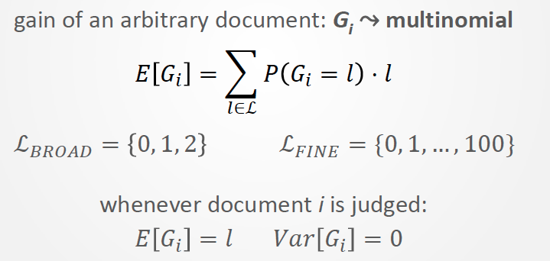
Incomplete Judgments
Model probabilistically the relevance judgments using random variables: G_{i}
Expectation and Variance:
.
Result: Comparison between systems, ranked
Notes:
Consequence:
Small and biased test collections
Solution:
Apply low-cost evaluation methodologies

Slide 19
Low cost evaluation methodologies
Crowdsorcing
Decrease number of judgments
Systems with incomplete judgments
Probabilistic Evaluation
(Carterette, Allan, & Sitaraman, 2006)
(Buckley and Voorhees, 2004)
(Alonso, Rose, & Stewart, 2008).
(Urbano, 2013)
(Spärk Jones & van Rijsbergen, 1975)
Notes:
Evaluación P: de las métricas que si quiere estimar anotaciones, minimizar varianza, estimar ranking.

Slide 20
Probabilistic Evaluation
To estimate the relevance of a document : to know: P(G_{i}=l) for each relevance level L: its distribution must be calculated
Two models were fitted to estimate these relevance judgments
Use this relevance judgments to evaluate systems using metrics
.
Result: Comparison between systems, ranked

Slide 21


Estimation of Relevance Judgments
Framework: Ordinal Logistic Regression

Slide 22
Probabilistic Evaluation
To estimate the relevance of a document : to know: P(G_{i}=l) for each relevance level L: the distribution of G_{i} must be calculated
Two models were fitted to estimate these relevance judgments
Use this relevance judgments to evaluate systems using metrics
.
Result: Comparison between systems, ranked

Slide 23
Output-based features
Used when there are not judgments: M_{out}
Feature | Description
fSYS | % of systems that retrieved d for q
OV | Degree of overlap between systems
sGEN | Whether the musical genre of d is the same as q
fGEN | % of al documents retrieved for q that belong to the same musical genre than d does
fART | % of documents retrieved for q that belong to the same artist as d does
Notes:
It can always be used

Slide 24
Judgment -based features
Used with known results: M_{jud}
Feature | Description
aSYS | Average relevance of documents retrieved by the system
aGEN | Average relevance of all the documents retrieved for q that belongs to the same genre as d does
aART | Average relevance of all the documents retrieved for q performed by the same artist as d .

Slide 25
Performance of Models
Model | R2 (Coefficient of Determination)
Mjud | 0.9
Mout | 0.35

Slide 26
Probabilistic Evaluation
To estimate the relevance of a document : to know: P(G_{i}=l) for each relevance level L: the distribution of G_{i} must be calculated
Two models were fitted to estimate these relevance judgments
Use this relevance judgments to evaluate systems using metrics
.
Result: Comparison between systems, ranked
Notes:
Consequence:
Small and biased test collections
Solution:
Apply low-cost evaluation methodologies

Slide 27
Estimation of Effectiveness
First Scenario: not relevance judgments available: Order of Systems->M_{out}
average accuracy of 92%
Average confidence in the rankings of 94%
Notes:
Here we use Mout

Slide 28
Estimation of Effectiveness
Second Scenario: systems differences.
Using 2% of judgments, differences are estimated in 93%
Notes:
We are estimating 93% using Mout; estimating it.

Slide 29
Estimation of Effectiveness
Third Scenario: the estimation of absolute effectiveness scores.
Using 25% of relevance judgments they can estimate with an error of +-0.05
Effectiveness in the ranking of systems is highly overestimated
Notes:
This will improve specially using the version of several models when there is no such a great amount of info

Slide 30
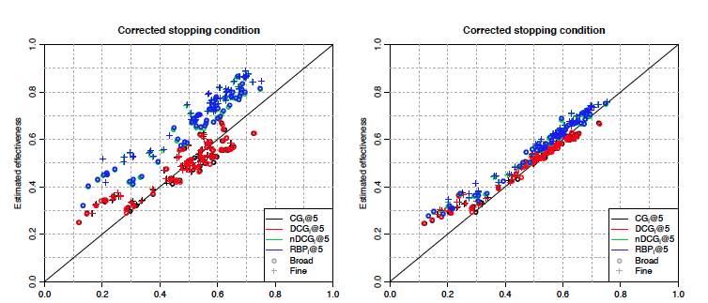
Estimation of Effectiveness
Fig 2. Estimated vs. actual absolute effectiveness scores in MIREX 2007, 2009, 2010 and 2011 when judging documents until expected error is +-0.05 with an uncorrected (left) or corrected (right) stopping condition. Adapted from ( Urbano, 2013)
Notes:
Models will improve this; ‘cos is overestimating.

Slide 31
Content
Motivation
State of the Art
Methodology

Slide 32
Methodology
1. Implementing others frameworks.
2. Implementing new attributes for models.
3. Using several models according to the amount of judgments
Notes:
Consequence:
Small and biased test collections
Solution:
Apply low-cost evaluation methodologies

Slide 33
1. Using other frameworks
Before we had Ordinal values 0,1,2…
Logit and Probit Regression
Estimated variable between [0-1]
Framework | RMSE | Variance
Logit | 4,5% | 7%
Probit | 2,8% | 6%
Notes:
First we used Ordinal Logistic Regression, when we had ordinal values 0,1,2
Now we modelate the variable as a real number and try to predict the number

Slide 34
1. Using other frameworks
Regression + trunking
Estimated variable, real number, truncated in the interval [0-1]
Framework | R²
Regression | -7%
Notes:
We use a real number that then we trunk between the interval [0-1]

Slide 35
Methodology
1. Implementing others frameworks.
2. Implementing new attributes for models.
3. Using several models according to the amount of judgments

Slide 36
2. New attributes
Backward elimination
MODELS TRIALS
Model | Predictors | Deviance
1 | fSYS * OV + fSYS * sGEN + fSYS * fGEN + fSYS * fART + OV * sGEN + OV * fGEN + OV * fART + sGEN * fGEN + sGEN * fART + fGEN * fART | 36.342
2 | fSYS + OV + sGEN + fGEN + fART | 37.203
3b | fSYS+OV | 44.532
3c | fSYS+sGEN | 40.483
3d | fSYS+fGEN | 38.477
3e | fSYS+fART | 43.346
3j | OV+sGEN | 40.693
3k | OV+fGEN | 38.416
3l | OV+fART | 43.534
3m | sGEN+fGEN | 38.049
3n | sGEN+fART | 39.426
3o | fGEN+fART | 38.031
5 | fSYS*fGEN + OV*fGEN + sGEN*fGEN + fGEN*fART | 36.401
Urbano, 2013
 | fSYS*OV + fART + sGEN*fGEN | 36.837
Notes:
We have been trying different interaction among variables and in the end the final model is too much complicated and then I decided to work with the model proposed by Urbano

Slide 37
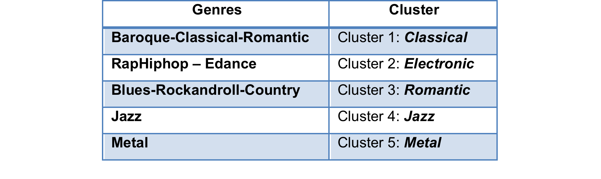
2. New attributes
Clustering genres by subjective similarity

Slide 38
2. Improved M_{out}
RMSE
-2,74%
R²
Broad: 11%
Var.
-5%

Slide 39
2. New attributes
GENRE q | GENRE d | Distances
JAZZ | JAZZ | 65,2
METAL | METAL | 63,3
CLASSICAL | CLASSICAL | 59,3
ELECTRONIC | ELECTRONIC | 58
ROMANTIC | ROMANTIC | 49
ROMANTIC | METAL | 39,2
ROMANTIC | JAZZ | 37,5
METAL | ELECTRONIC | 28,2
ELECTRONIC | ROMANTIC | 20,4
CLASSICAL | JAZZ | 17,5
ELECTRONIC | JAZZ | 16,5
METAL | JAZZ | 16,1
JAZZ | ELECTRONIC | 13
ROMANTIC | ELECTRONIC | 12,9
CLASSICAL | ROMANTIC | 12,4
METAL | CLASSICAL | 9,8
ROMANTIC | CLASSICAL | 8,9
JAZZ | METAL | 8,6
CLASSICAL | ELECTRONIC | 6,4
CLASSICAL | METAL | 4,8
ELECTRONIC | CLASSICAL | 4,7
Implementing similarity-distances between genres of query - document
Notes:
We use distance between genres to improve what I did before
Is simiraity not distance, higher more similar; most similar is the same genre
Same genre high similitud, low similarity distinct genres

Slide 40
2. Improved M_{out}
RMSE
-5,28%
R²
Broad: 21%
Fine: 23%
Var.
-7,05%

Slide 41
Content
Motivation
State of the Art
Methodology
Results
Short-term planning

Slide 42
Short-term planning
Task | Description | Date
New features for artist | Ex: Metadata from Internet Musical Databases. | June 26th – July 15 ^{th}
Training models to predict using different amount of available information | Training models using less data in order to consider the cases in which not much (incomplete) information will be available. | June 26th – July 15 ^{th}
Coding the model | Coding in JAVA or C++ to interact with the other system | July 16 ^{th} to 31 ^{th}
Finishing the monograph | Consigning the final results or the research. | August 1 ^{th} -20 ^{th}
Final Revision by Advisor |  | August 21 ^{th} - 31 ^{th}

Slide 43
Thanks! Gracias Gràcies

